Slide 1
Healthcare Management System
Group Number: 19
Members:
Aakruti Ghatole
Neha Mahangade
Suhas Kommuri
Anurag Kashyap

Slide 2
Project and its Purpose
Efficiently managing patient information is critical in healthcare. Challenges like scattered files and poor communication hurt care quality and record maintenance. This project aims to address these by creating a secure, user-friendly platform that simplifies patient management, improves operational efficiency, and ensures robust data protection.
By focusing on seamless communication, task automation, and patient empowerment, the system promises scalability and adaptability to meet evolving industry needs.

Slide 3
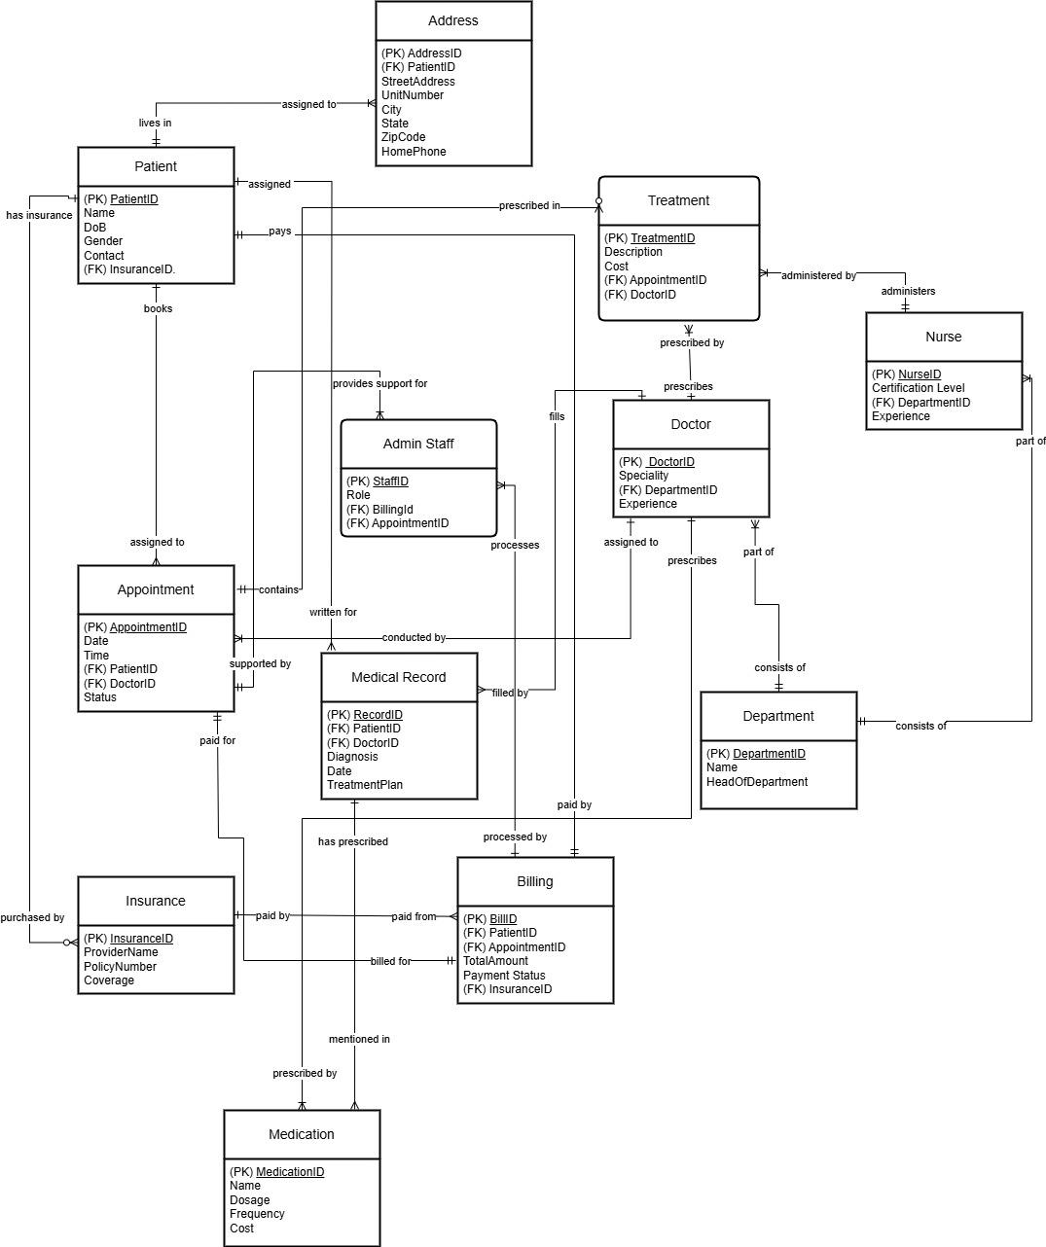
Entity Relationship Diagram

Slide 4
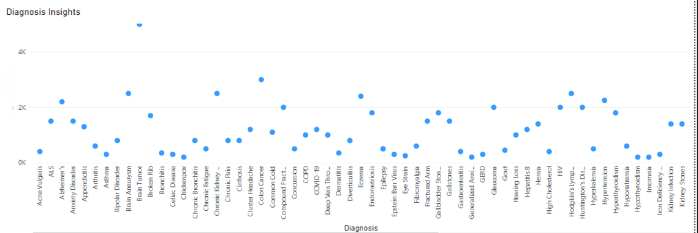
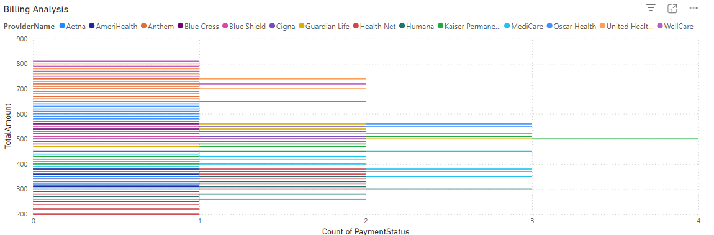
Data Visualisation - Diagnostics Count
Data Visualisation - Billing

Slide 5
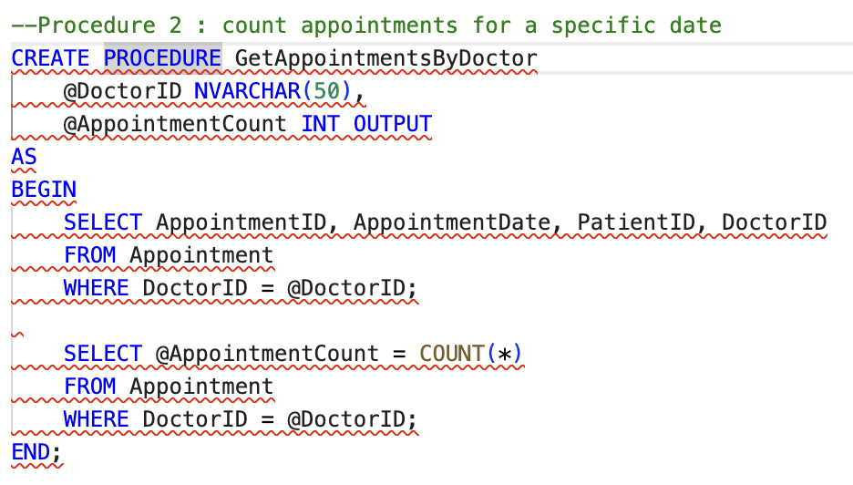
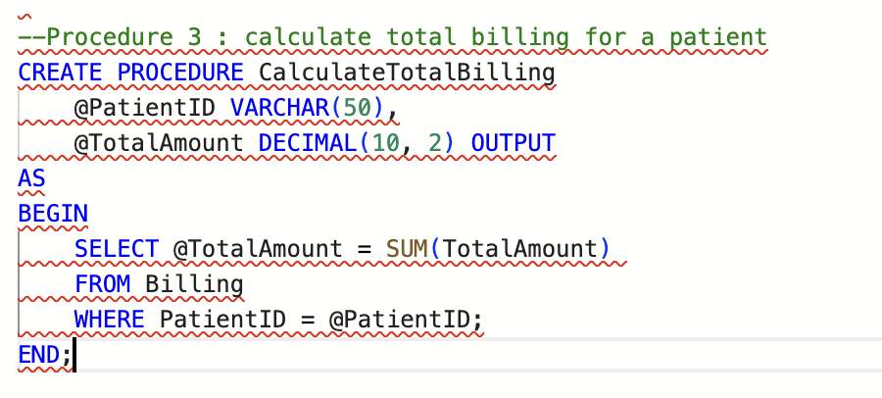
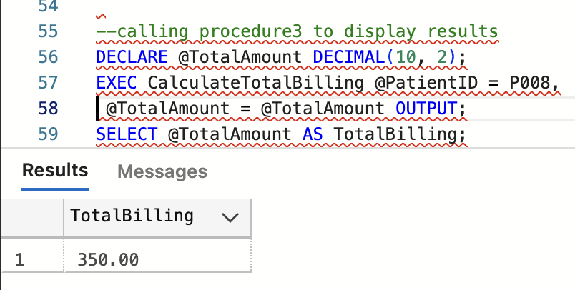
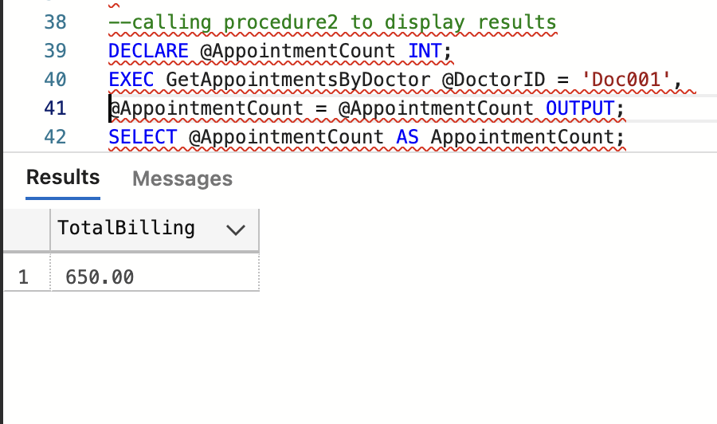
Stored Procedures
Stored procedure to count all appointments for a specific date :
Stored procedure to calculate total billing for a patient :

Slide 6
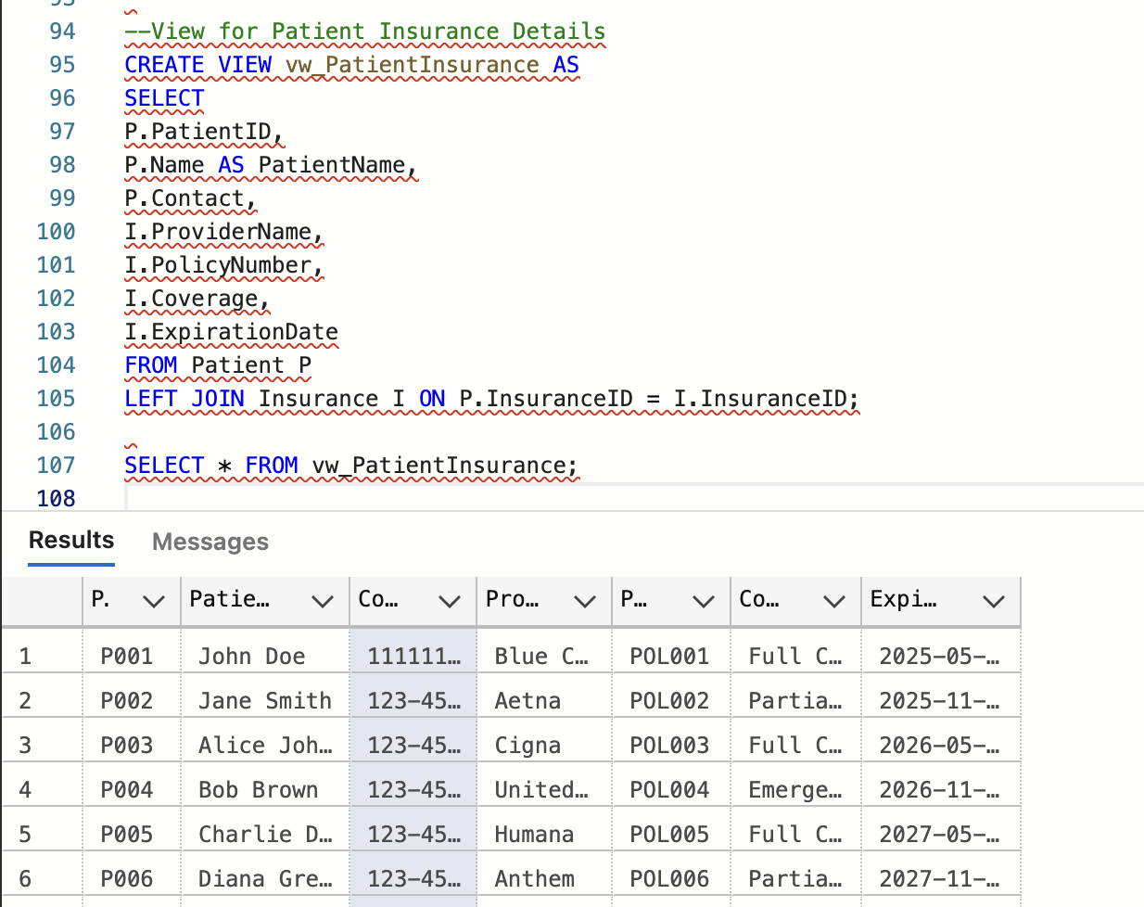
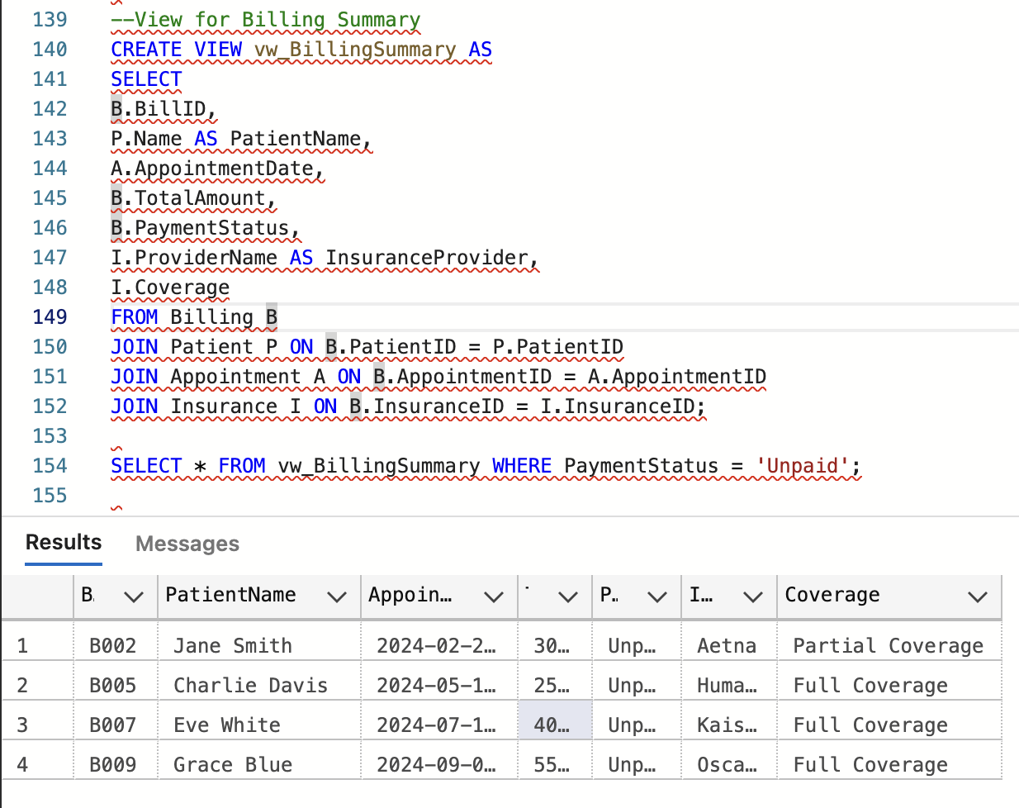
Views
View for patient insurance details :
View for billing summary :

Slide 7
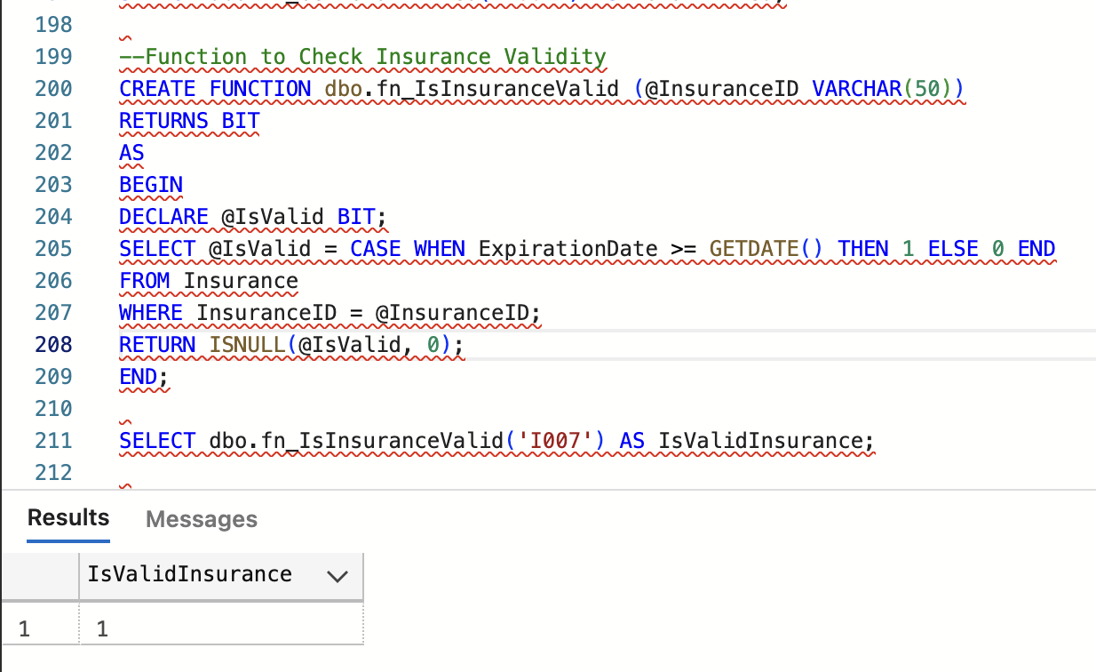
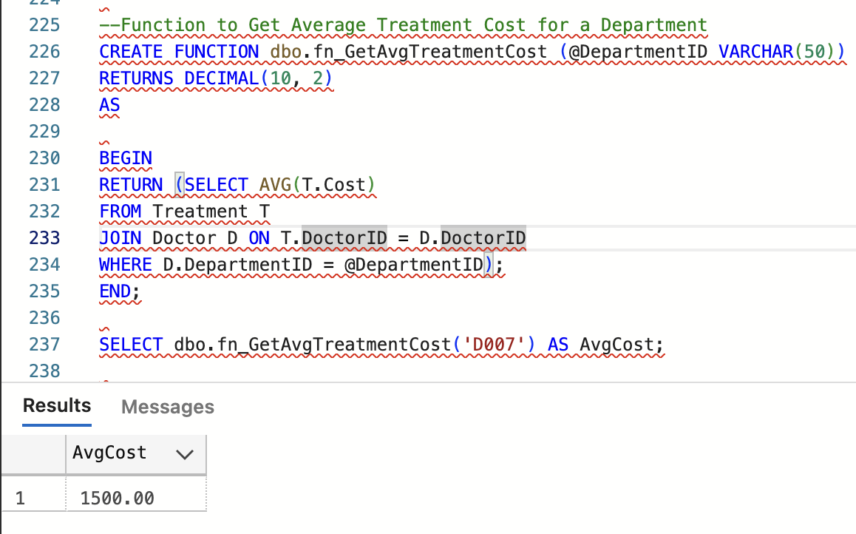
User defined Functions
Function to check insurance validity :
Function to get average treatment cost for a department:

Slide 8
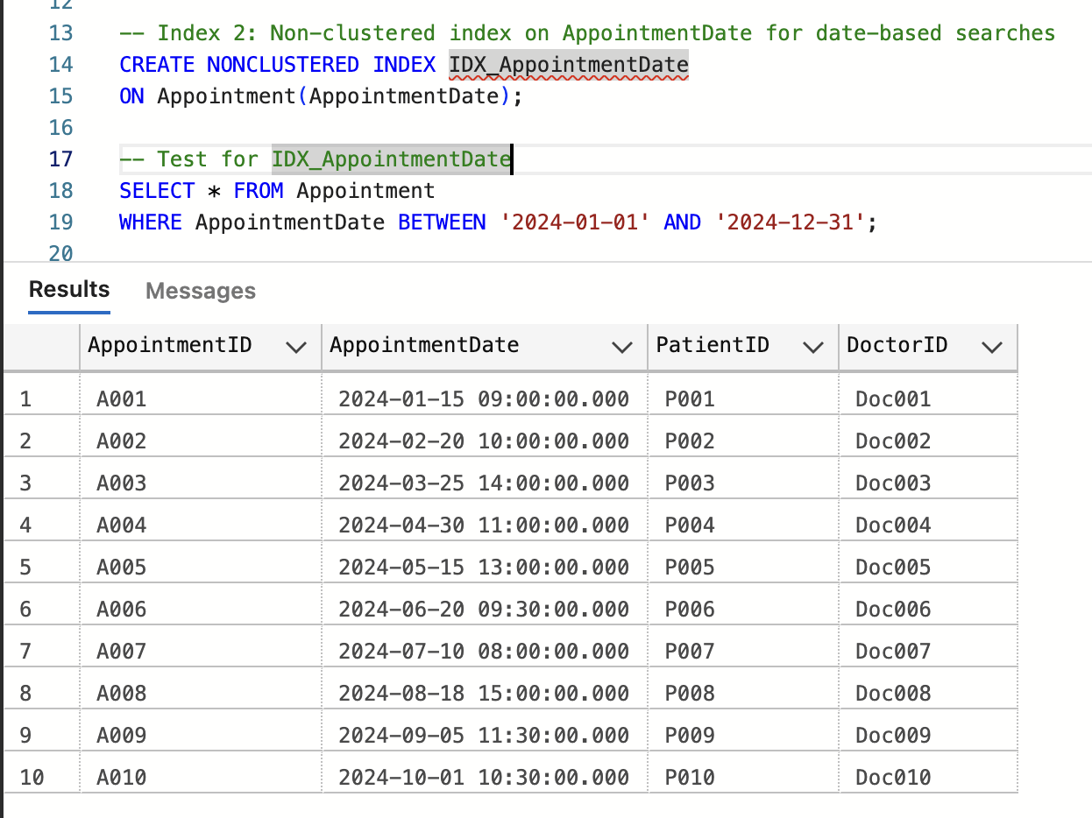
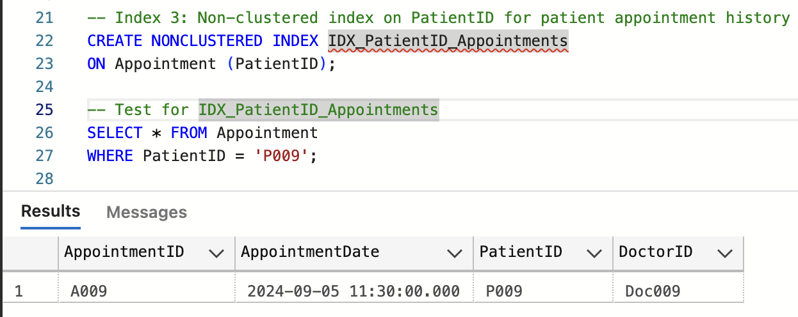
Indexes :
Index on appointment date for date based searches
Index on patient for appointment history

Slide 9
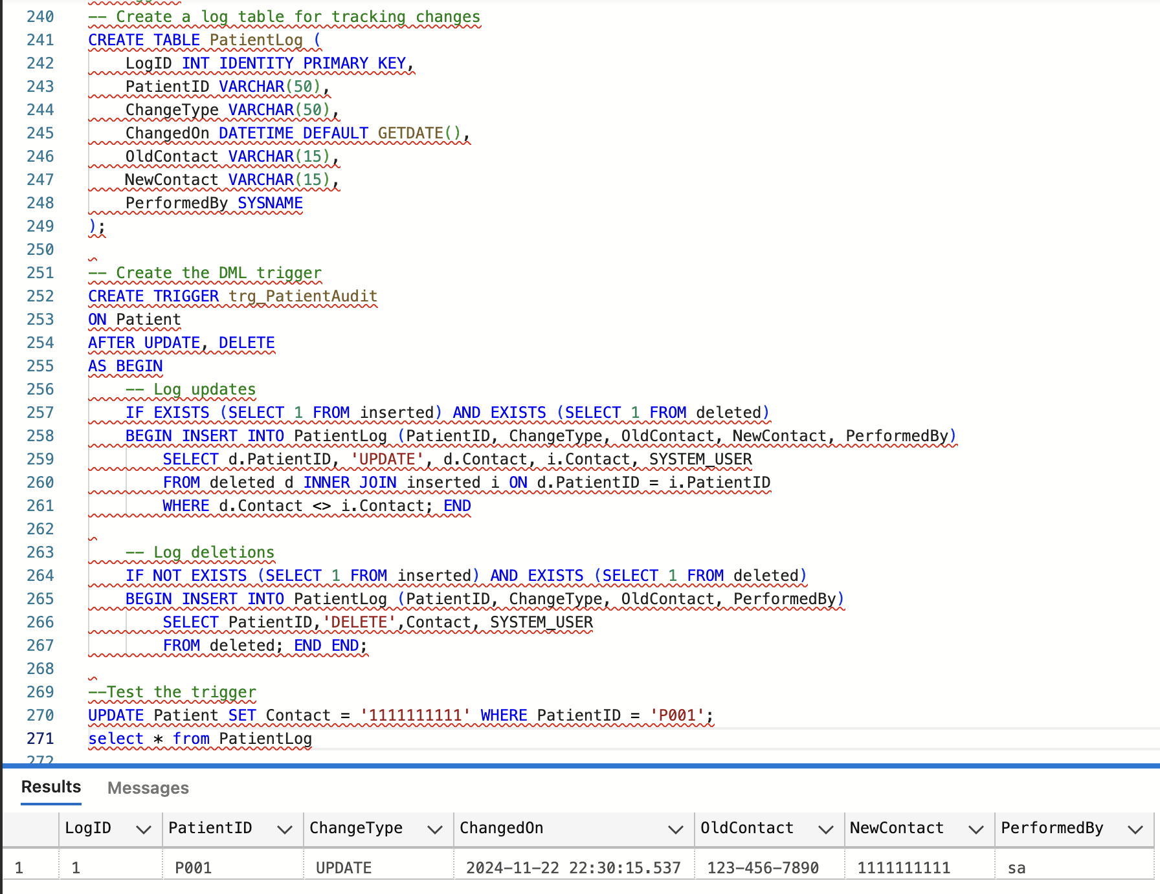
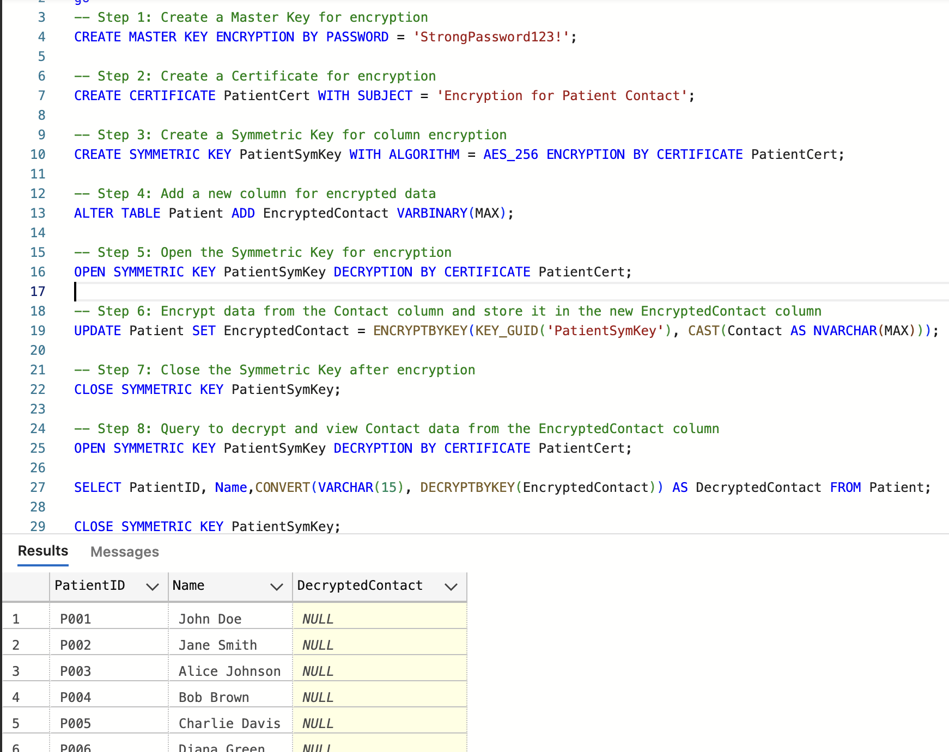
Trigger : tracking all DML changes to the patient table
Encryption on patient table for contact details column

Slide 10
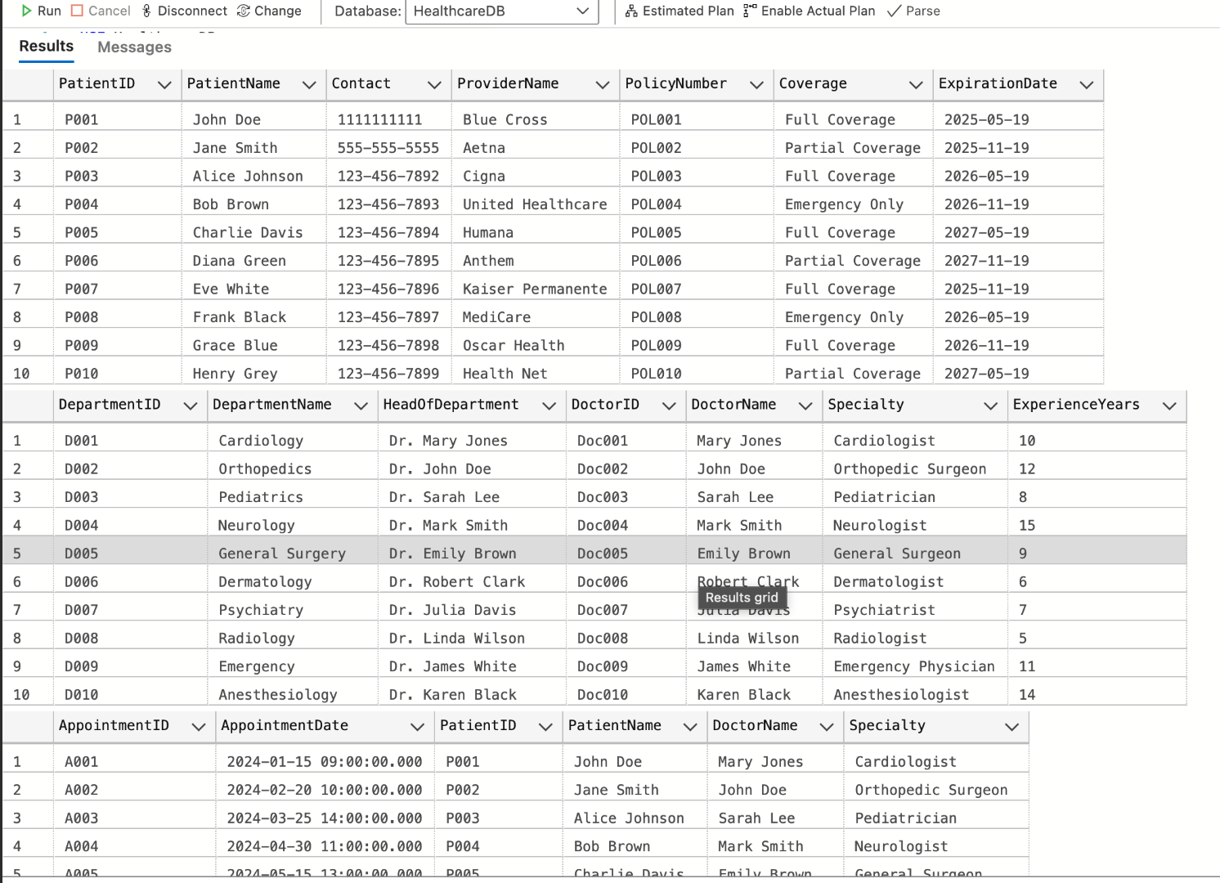
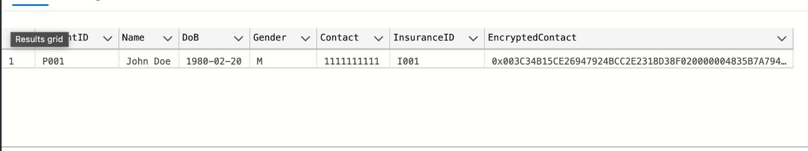
Sample Execution of GUI

